Slide 1
Royal College of Surgeons in Ireland Coláiste Ríoga na Máinleá in Éirinn
Modification of potentially inappropriate prescribing following fall-related hospitalisations in older adults
Mary Walsh, Frank Moriarty, Fiona Boland, Tom Fahey
AUDGPI Annual Scientific Meeting, RCSI, Dublin, 1st March 2019

Slide 2
Declaration of Conflicts of Interest
The authors declare no conflicts of interest

Slide 3
Background
30% of older adults fall each year and 20% of falls require medical care
Strong evidence that medications including sedatives, hypnotics, and benzodiazepines are associated with falls
Falls that require hospitalisation should trigger a review of medication

Slide 4
Medications Related to “Falls-Risk” (O'Mahony et al 2015)
Background
STOPP (Medications that are potentially inappropriate to prescribe)
Sedatives:
Benzodiazepines | Sedative, may cause reduced sensory input and impair balance
Neuroleptic drugs | May cause gait dyspraxia, Parkinsonism
Z-drugs | Hypnotic, may cause protracted daytime sedation, ataxia
Vasodilator drugs | In people with persistent postural hypotension
START (Medications that should be considered if no contraindications)
Vitamin D supplement | In older people who are housebound/ experiencing falls/ with osteopenia. Aim to reduce fracture risk

Slide 5
Aim and Objectives
Aim: To explore patterns of relevant potentially inappropriate prescribing (PIP) in older people with fall-related hospital admissions
Objectives:
To estimate and compare the prevalence of PIP in this population pre and post hospitalisation
To identify factors associated with post-hospitalisation prescription modification
To summarise the prevalence of post-hospitalisation prescription modification by prescription data source (General Practice versus Hospital)

Slide 6
Methods
Data Source
44 general practices in the Republic of Ireland
Data collected from patient-management software system
Patients 65 years and older
Between January 2011 and 2016

Slide 7
Methods
Selection of Fall-related Hospitalisations
Fall, Fracture or Syncope as diagnosis
Only first selected if more than one fall-related hospitalisation
3-month exclusion period at start and end of data-collection to ensure sufficient prescription data either side

Slide 8
Methods
Sources of Prescription Data
General Practice (GP) Prescription Records: selected for each participant for 12 months prior to and 12 months after hospitalisation
At Discharge from Hospital: Recorded through discharge summaries sent electronically to General Practice

Slide 9
Methods
Outcomes
Prescription of medications related to falls-risk (Sedatives, Vasodilators, Vitamin D)
Independent variable
Time-period: after versus prior to fall-related hospitalisation
Covariates
Age, sex, health cover, admission diagnosis, number of prescription records and items per prescription, other hospitalisations, hospital
Population
Persons with fall-related hospitalisations

Slide 10
Methods
Four Logistic Regression Analyses
Prescription of Vitamin D
Prescription of Sedatives
Prescription of Vasodilators:
In all patients
In just those with Syncope diagnosis
Pre-hospitalisation prescription
(GP Prescription records)
Post-hospitalisation
prescription
(In Discharge Medication Summary OR GP Prescription records)
Fall-related Hospitalisation

Slide 11
Methods
Exploration of association between demographic and clinical factors (age, sex and admission diagnosis) and medication prescription in those on and not on medication pre-hospitalisation
Breakdown of PIP Modification/ New PIP by Prescription Data Source in those with data from both sources available
Post-hospitalisation
prescription:
GP Prescription records
Pre-hospitalisation prescription
(GP Prescription records)
Post-hospitalisation
prescription: Discharge Medication Summary
Post-hospitalisation
prescription:
GP Prescription records
Fall-related Hospitalisation

Slide 12
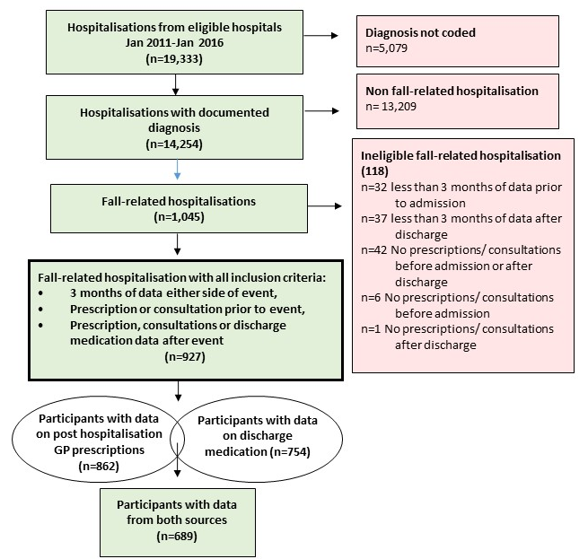
Results
Main Analysis
Secondary Analysis

Slide 13
Results
Participant Characteristics (n=927)
Sex (Female) | 68% | n= 626
Admission Diagnosis
Fall with no fracture | 27% | n= 252
Fracture | 45% | n= 413
Syncopal episode/ collapse | 28% | n= 262
Age at admission | Mean 81.2 (SD=8.6)
Length of hospital stay | Median 7 days (IQR 2-17)
Number of different meds/ script
Pre hospitalisation | Mean 4.8 (SD=2.6)
Post hospitalisation | Mean 5.5 (SD=2.9)

Slide 14
Results
Medication Prescription Pre and Post Hospitalisation (n=927)
Medication grouping | Pre- Hospitalisation n (%) | Post Hospitalisation n (%) | p-value (McNemar’s Test)
Vitamin D | 342 (37%) | 478 (52%) | <0.01
Sedatives | 369 (40%) | 421 (45%) | <0.01
Benzodiazepines | 190 (21%) | 210 (23%) | 0.06
Z-drugs | 171 (18%) | 207 (22%) | <0.01
Neuroleptics | 108 (12%) | 135 (15%) | <0.01
Vasodilators | 498 (54%) | 503 (54%) | 0.70

Slide 15
Results - Time period
1. Vitamin D Prescription
2. Sedative Prescription
3a. Vasodilator Prescription
3b. Vasodilator Prescription in “Syncope” subgroup (n=262)
Pre Hospitalisation
Post Hospitalisation
Adjustments made for: Age, Sex, Health cover, No. of prescription records, number of medications per prescription, Length of observation, other hospitalisations, Hospital, (and for n=927, Admission diagnosis). Clustering at GP practice level

Slide 16
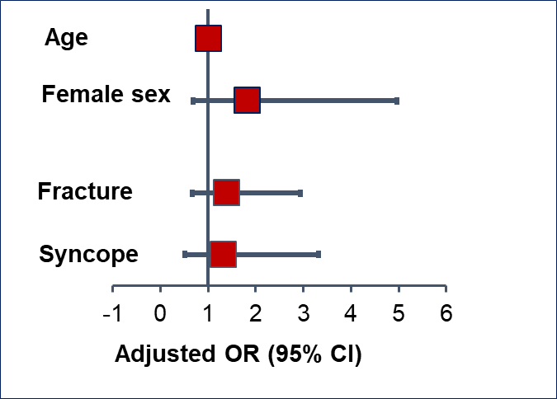
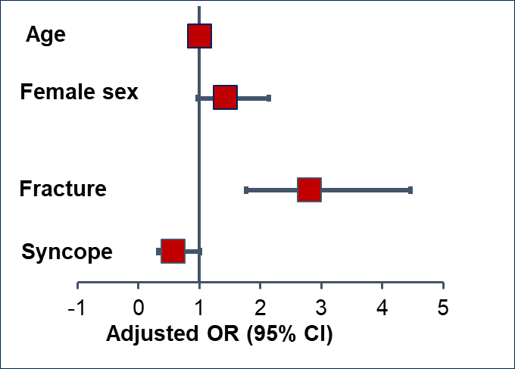
Results –Vitamin D
On vitamin D prior to hospital admission (n=342) |  |  | NOT on vitamin D prior to hospital admission (n=585)
Prescription continued | Prescription not continued |  | New initiation of prescription | No initiation of prescription
88% | 12% |  | 30% | 70%
Factors associated with continuation
of Vitamin D
Factors associated with new initiation
of Vitamin D
Diagnosis*
Diagnosis*
*Fall without fracture or syncope= reference category

Slide 17
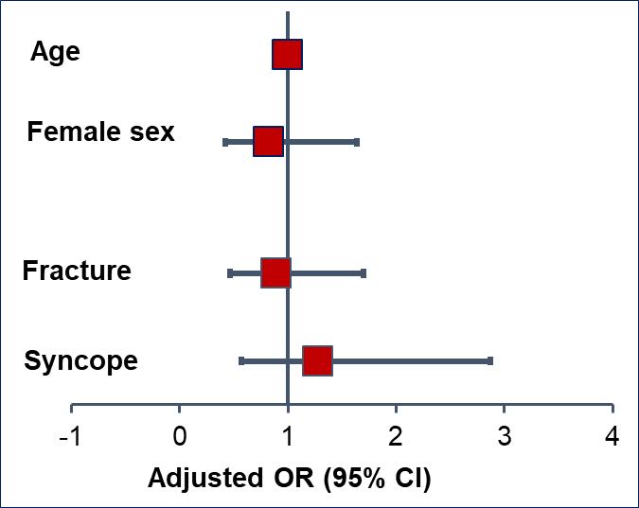
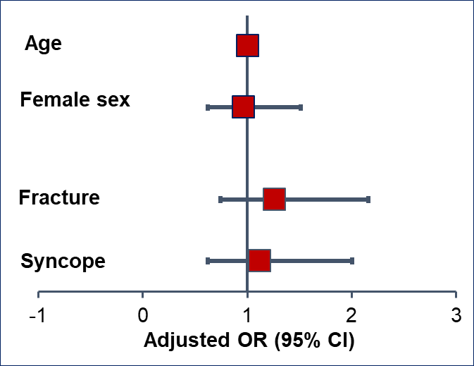
Results – Sedatives
On sedatives prior to hospital admission (n=369) |  |  | NOT on sedatives prior to hospital admission (n=558)
Prescription continued | Prescription not continued |  | New initiation of prescription | No initiation of prescription
84% | 16% |  | 20% | 80%
Factors associated with continuation
of Sedatives
Factors associated with new initiation
of Sedatives
Diagnosis*
Diagnosis*
*Fall without fracture or syncope= reference category

Slide 18
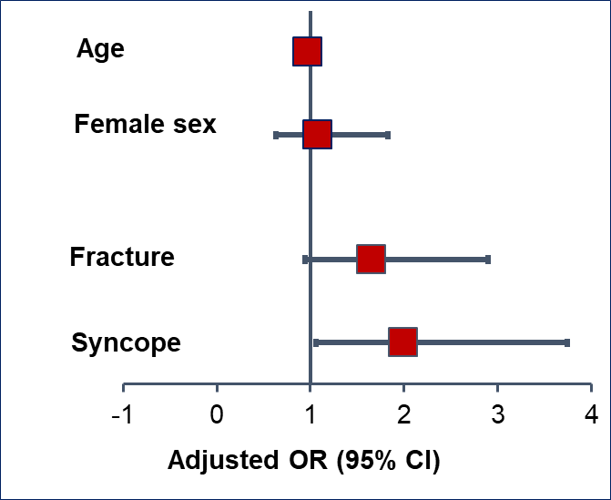
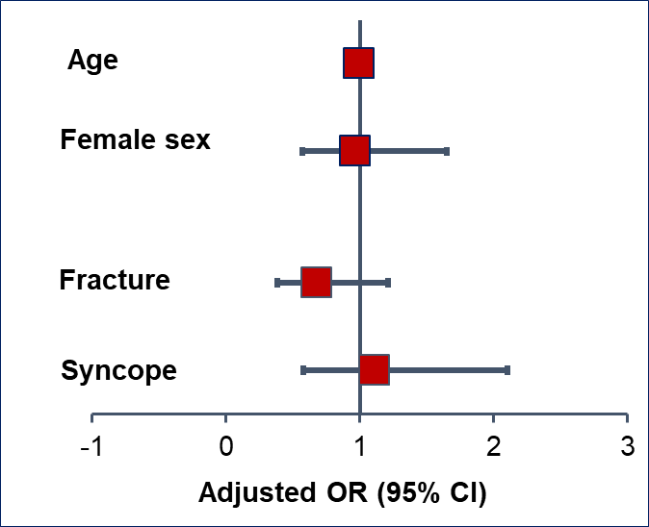
Results – Vasodilators
On vasodilators prior to hospital admission (n=498) |  |  | NOT on vasodilators prior to hospital admission (n=429)
Prescription continued | Prescription not continued |  | New initiation of prescription | No initiation of prescription
84% | 16% |  | 20% | 80%
Factors associated with continuation
of Vasodilators
Factors associated with new initiation
of Vasodilators
Diagnosis*
Diagnosis*
*Fall without fracture or syncope= reference category

Slide 19
Results Secondary Analysis (n=689)
Modification of PIP Post Hospitalisation according to Prescription Source
Medication Group | Number on medication at baseline | Medication in either source | Medication in Discharge Summary | Medication in GP Prescription Records
Vitamin D | 0 | 150/ 423 (35%) | 86/ 423 (21%) | 132/ 423 (31%)
Sedatives | 278 | 237/ 278 (85%) | 130/ 278 (47%) | 231/ 278 (83%)
Vasodilators | 374 | 332/ 374 (89%) | 259/ 374 (69%) | 308/ 374 (82%)
New PIP Post Hospitalisation according to Prescription Source
Vitamin D | 266 | 241/ 266 (91%) | 172/ 266 (65%) |  | 238/ 266 (89%)
Sedatives | 0 | 90/ 411 (22%) | 30/ 411 (7%) |  | 77/ 411 (19%)
Vasodilators | 0 | 71/ 315 (23%) | 48/ 315 (15%) |  | 52/ 315 (17%)

Slide 20
Summary
Prescription of sedative medications is prevalent in older adults and increases after hospitalisation for a fall event. This contrasts with the advice of prescribing guidelines.
New initiation of vitamin D was also frequent after a fall-related admission
New initiation of sedatives was not found to be associated with demographic factors or type of fall experienced
New initiation of sedatives not confined to secondary care
Future studies should investigate why new initiation of falls-related PIP may occur in this population to inform and improve deprescribing interventions

Slide 21
Discussion
Evidence for vitamin D in those with deficiency only and adherence can be problem
Deprescribing of long-term sedatives very challenging - especially for insomnia
Relationship between cardiovascular medications and falls unclear Syncope diagnosis not necessarily “persistent postural hypotension”
Falls are multifactorial and prevention requires co-ordinated approach
Limitations of study:
Focus on STOPP/ START guidelines
Reliant on routinely recorded data

Slide 22
Article in press
Drugs & Aging
“MODIFICATION OF POTENTIALLY INAPPROPRIATE PRESCRIBING FOLLOWING FALL-RELATED HOSPITALIZATIONS IN OLDER ADULTS”
DOI :10.1007/s40266-019-00646-z.

Slide 23
Acknowledgements
Funding for this research from the Health Research Board (HRB) through the HRB Centre for Primary Care Research (grant no. HRC/2014/01)
Participating general practitioners and patients
Email: maryewalsh@rcsi.ie
Website: www.hrbcentreprimarycare.ie
Twitter: @MaryWalsh14 @HRBPrimaryCare

Slide 24
References
de Groot DA, de Vries M, Joling KJ, van Campen JP, Hugtenburg JG, van Marum RJ, et al. Specifying ICD9, ICPC and ATC codes for the STOPP/START criteria: a multidisciplinary consensus panel. Age ageing. 2014;43(6):773-8
Hill-Taylor B, Sketris IS, Gardner DM, Thompson K. Concordance with a STOPP (Screening Tool of Older Persons' Potentially Inappropriate Prescriptions) Criterion in Nova Scotia, Canada: Benzodiazepine and Zoplicone Prescription Claims by Older Adults with Fall-related Hospitalizaions. J Popul Ther Clin Pharmacol. 2016;23(1):e1-12
McMahon CG, Cahir CA, Kenny RA, Bennett K. Inappropriate prescribing in older fallers presenting to an Irish emergency department. Age ageing. 2014;43(1):44-50
Nauta KJ, Groenhof F, Schuling J, Hugtenburg JG, van Hout HPJ, Haaijer-Ruskamp FM, et al. Application of the STOPP/START criteria to a medical record database. Pharmacoepidemiol Drug Saf. 2017;26(10):1242-7
O'Mahony D, O'Sullivan D, Byrne S, O'Connor MN, Ryan C, Gallagher P. STOPP/START criteria for potentially inappropriate prescribing in older people: version 2. Age ageing. 2015;44(2):213-8
Reeve E, Ong M, Wu A, Jansen J, Petrovic M, Gnjidic D. A systematic review of interventions to deprescribe benzodiazepines and other hypnotics among older people. Eur J Clin Pharmacol. 2017;73(8):927-35
Woolcott JC, Richardson KJ, Wiens MO, Patel B, Marin J, Khan KM, et al. Meta-analysis of the impact of 9 medication classes on falls in elderly persons. Archives of internal medicine. 2009;169(21):1952-60

Slide 25
Methods Definition of Medications Related to “Falls-Risk”
Medication Group | Specific medications
Benzodiazepines | Benzodiazepines and benzodiazepine derivates
Neuroleptic drugs | Antipsychotics, except lithium
Hypnotic Z-drugs | Benzodiazepine related agents e.g. Zopiclone, Zolpidem, Zaleplon
Vasodilator drugs | Vasodilator agents, direct vasodilators, selective alpha-receptor blockers, calcium channel blockers, ACE-inhibitor and combinations, angiotensin II receptor blocker and combinations
Vitamin D supplement | Calcium and vitamin D, vitamin D and analogues or vitamin A

